Slide 1

Trumpocalypse!
A satirical text based survival game
(For CSC446) Group: David Shumway, Jesse Thew, Nick DeAguiar, Roland Carignan(PM)
Customer: Muhtasim Mahir

Slide 2
Problem Statement
This game is meant to shed some light on these dark days with a little fun and satirical comedy at Trump’s expense. There will be some educational aspects about modern American politics, natural disasters, and how americans managed to survive this time period.

Slide 3
User actions
Start- Begin the Adventure! (leads to Character Creation) Options- Sound volume and other game options (not implemented) Highscore- View and or reset highscores FAQ- Items and their specific uses along with educational facts on events Quit

Slide 4
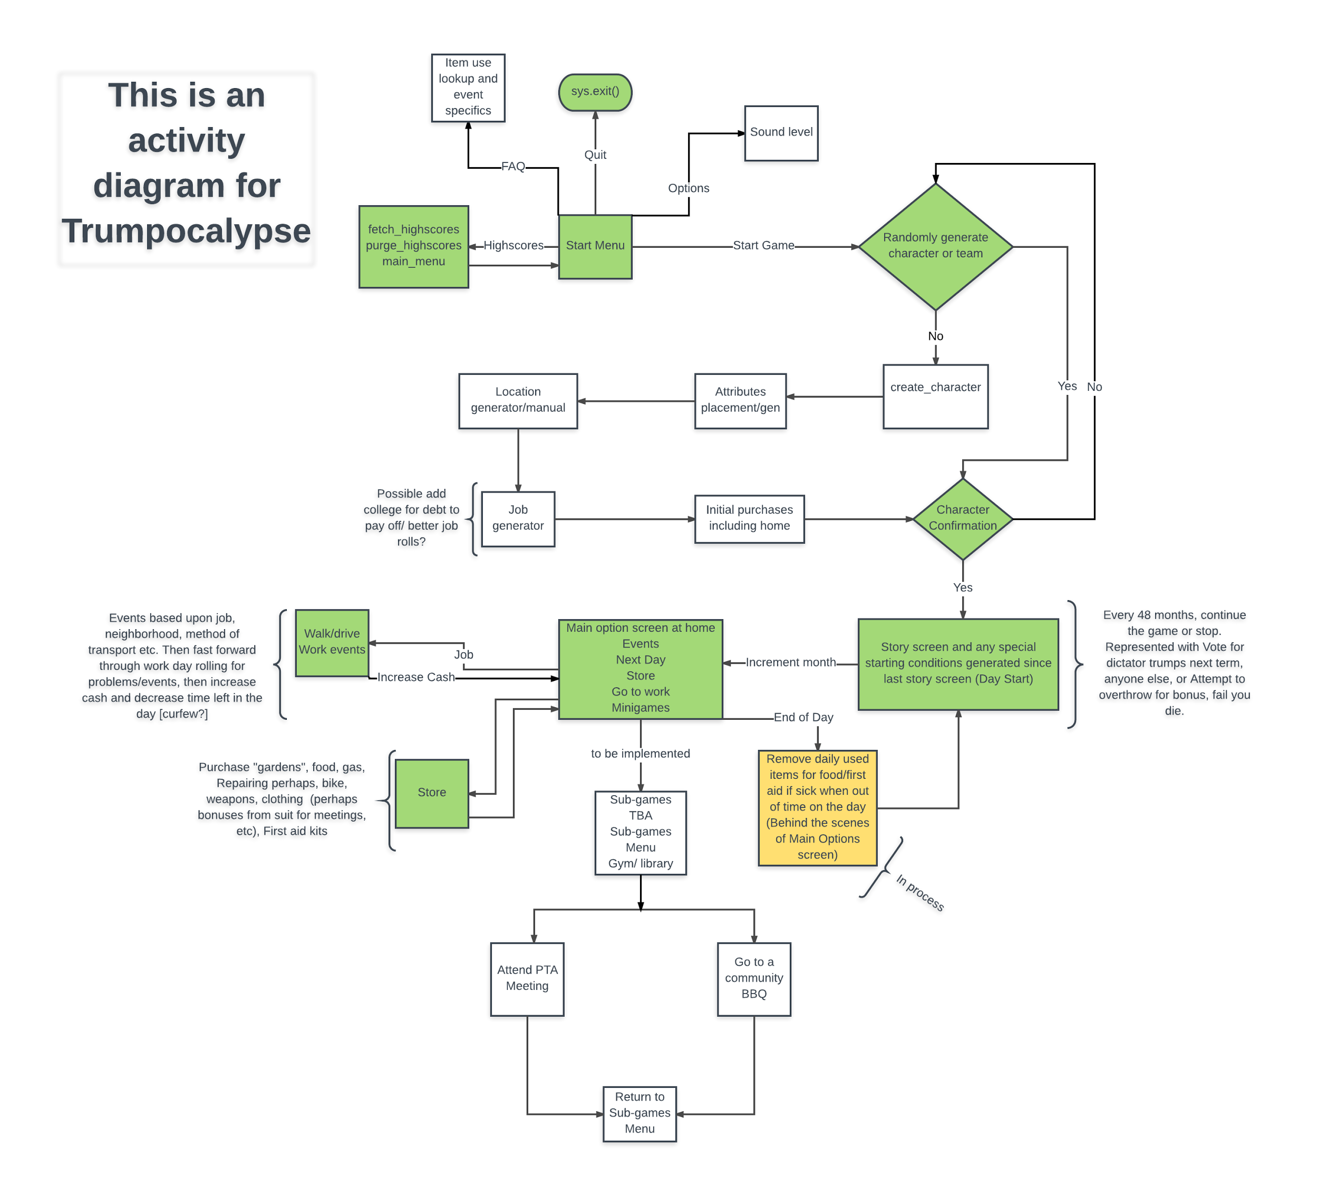
A link to the full diagram This diagram attempts to show all user actions.

Slide 5
Input Data required Manual Character Creation Name Location Attributes Automatic None

Slide 6
Frequency of Actions Everything before main story screen, rare.[Once per start] Load Story screen, Often[once a day] Main Day screen, very often [every day] Job, Often [once a day] Store, Occasional [fluctuates from [>1 a day to multiple] Events processing, Often [once a day on average] Next Day, Often [once a day on average] Minigames, Often [likely at least once a day]

Slide 7
Motivation for our Data Structures
Series of Classes : Inheritance. We wanted to use the same key press functionality in all classes for menus. Global Variable: Easy access for game state information.
Lists: Store information for Shops and the inventory as well as the menu options on each screen. Dictionaries: Good to store and display key value pairs for easy lookup, like Inventory items

